Slide 1
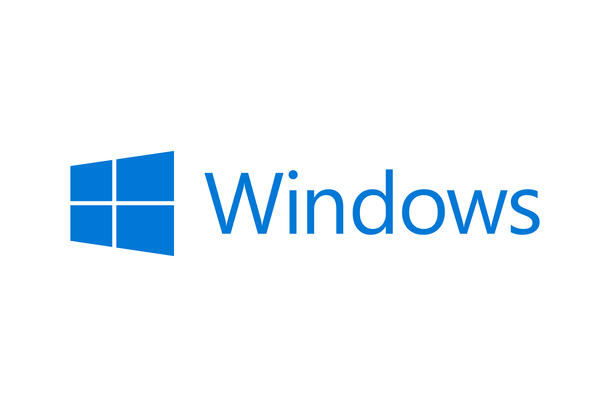


Which OS is best OS?
macOS
Linux
Windows

Slide 2
macOS
Pros
Cons
Can be managed en masse with tools like Jamf Pro
MS Office apps are avalable
Easily sync data across Apple devics with iCloud and iMessage
Great battery life
Hardware replacement and support through VARs (Value added resellers) is amazing
Most of the user base is familiar with the UI
Devices are largely not servicable
Devices are at a premium price point
Some open source apps do not have a macOS download available
Cannot easily install or support macOS on non-apple hardware

Slide 3
Linux
Pros
Cons
Distributions are Free
Each user can customize the distribution as they see fit
Can run on older hardware with ease
Can be managed with tools like Puppet and Salt
Large learning curve with most users
Support for core business apps is very inconsistent
No Office 365 support (must use web apps)
Device management tools require experienced systems administrators
Driver packages are tricky to manage, making plug-and-play inconsistent

Slide 4
Windows
Pros
Cons
Standard OS for most PCs
Supports most applications
WSL (windows subsystem for linux) can be used for Linux applications and is supported by Microsoft
Wide range of price ranges for supported hardware
Easily managed by Azure Active Directory, Asible, etc
Most users familiar with the UI (user interface)
Widely targeted by malware
Base OS uses most resources our of the 3
Updates often introduce breaking changes
Battery life for machines is highly variable

Slide 5
Non-Profit OS Overview
macOS: This OS will require expensive hadware, but works well within the apple ecosystem that all the employees are familiar with
Windows: Easy to implement, but may also not wake up from sleep
Linux: cheap, but hard to manage and has a very high learning curve
Verdict: macOS

Slide 6
Interior Design firm
OS Overview
macOS: some software may need a windows partition, but the battery life is amazing.
Windows: compatible with all software the firm uses, but also suffers from inconsistent battery life
Linux: cheap, but hard to manage and has a very high learning curve
Verdict: Windows

Slide 7
Social Media Advertisisng Agency
OS Overview
macOS: some software may need a windows partition, but the battery life is amazing.
Windows: compatible with all software the firm uses, but also suffers from inconsistent battery life
Linux: inexpensive, but hard to manage and has a very high learning curve
Verdict: Windows

